Slide 1

Correlation & Regression

Slide 2
Correlation
Finding the relationship between two quantitative variables without being able to infer causal relationships
Correlation is a statistical technique used to determine the degree to which two variables are related

Slide 3
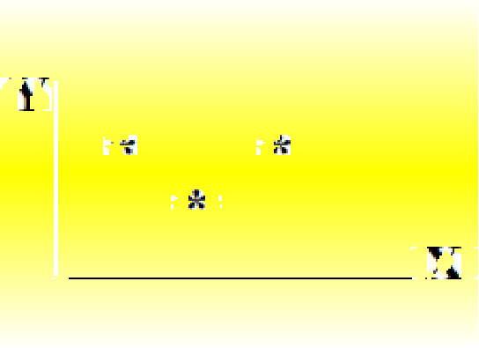

Scatter diagram
•
•
Rectangular coordinate Two quantitative variables
One variable is called independent (X) and the second is called dependent (Y)
Points are not joined No frequency table
•
•
•

Slide 4

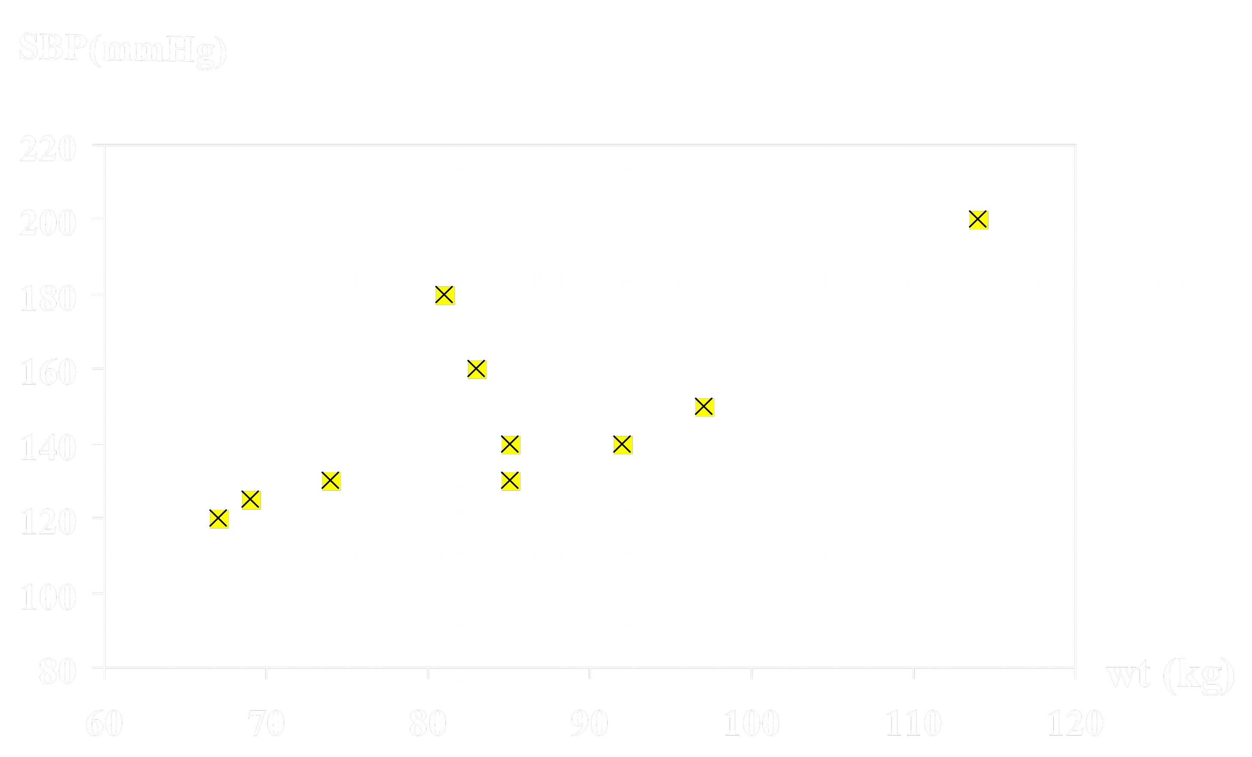
Scatter diagram of weight and systolic blood pressure

Slide 5
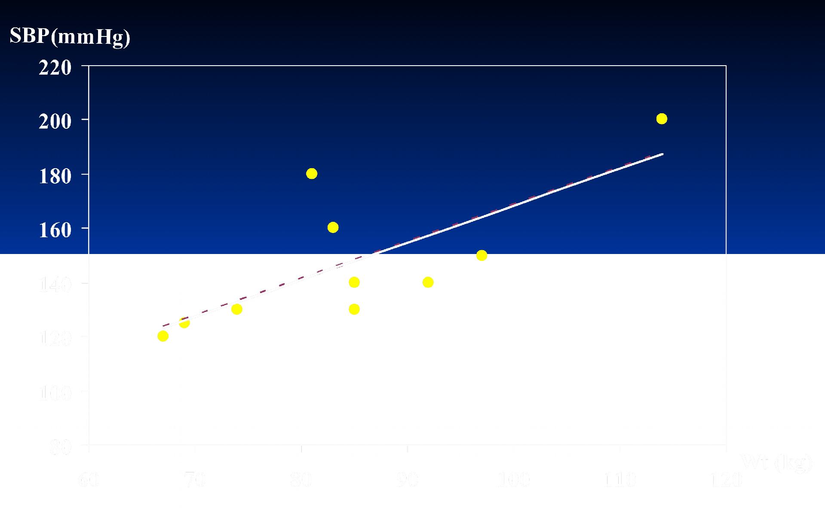

Scatter diagram of weight and systolic blood pressure

Slide 6
Scatter plots
The pattern of data is indicative of the type of relationship between your two variables:
positive relationship
negative relationship
no relationship

Slide 7
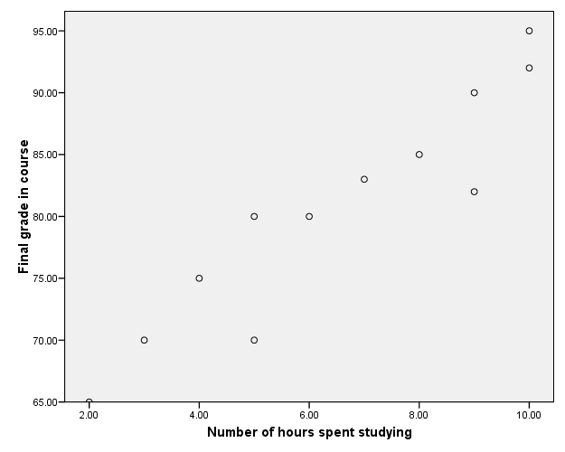
Positive relationship

Slide 8
Negative relationship
Reliability
Age of Car

Slide 9
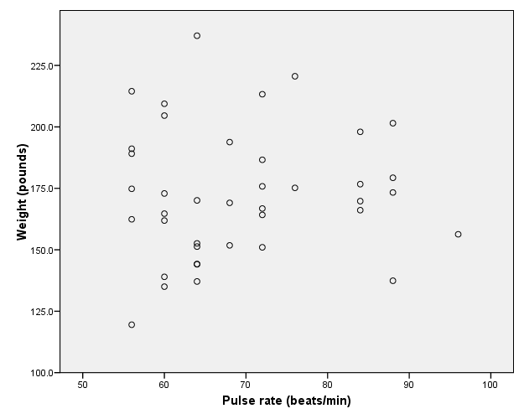
No relation

Slide 10
Correlation Coefficient
Statistic showing the degree of linear relationship between two variables

Slide 11
Simple Correlation coefficient (r)
It is also called Pearson's correlation or product moment correlation coefficient.
It measures the nature and strength between two variables of
the quantitative type.

Slide 12
The sign of r denotes the nature of association
while the value of r denotes the strength of association.

Slide 13
If the sign is +ve this means the relation is direct (an increase in one variable is associated with an increase in the other variable and a decrease in one variable is associated with a decrease in the other variable).
While if the sign is -ve this means an inverse or indirect relationship (which means an increase in one variable is associated with a decrease in the other).

Slide 14
The value of r ranges between ( -1) and ( +1)
The value of r denotes the strength of the association as illustrated
by the following diagram.
strong
intermediate
weak
weak
intermediate
strong
1-
-0.75 -0.25
0
0.25 0.75
1
indirect
Direct
perfect correlation
perfect correlation
no relation

Slide 15
If r = Zero this means no association or correlation between the two variables.
If 0 < r < 0.25 = weak correlation.
If 0.25 ≤ r < 0.75 = intermediate correlation. If 0.75 ≤ r < 1 = strong correlation.
If r = l = perfect correlation.

Slide 16
∑ xy−^{∑ x ∑ y}
How to compute the simple correlation coefficient (r)
√
_{r =} n
(
∑
x )
2
(
∑
y )
2
∑ x −
. ∑ y −
2
2
n
n

Slide 17
:Example
A sample of 6 children was selected, data about their age in years and weight in kilograms was recorded as shown in the following table . It is required to find the correlation between age and weight.
serial No | Age (years) | Weight (Kg)
1 | 7 | 12
2 | 6 | 8
3 | 8 | 12
4 | 5 | 10
5 | 6 | 11
6 | 9 | 13

Slide 18
These 2 variables are of the quantitative type, one variable (Age) is called the independent and denoted as (X) variable and the other (weight) is called the dependent and denoted as (Y) variables to find the relation between age and
weight compute the simple correlation coefficient using the following formula:
∑ xy−^{∑ x ∑ y}
_{r =} n
√
(∑ x )²
( ∑ y )²
( ) ( )
∑
2
∑
2
x −
.
y −
n n

Slide 19
Age (years)
(x)
7
6
8
5
6
9
=x∑ 41
Weight (Kg)
(y)
12
8
12
10
11
13
=y∑ 66
Serial
.n
_{X}2
_{Y}2
xy
1
2
3
4
5
6
Total
84
48
96
50
66
117
xy=∑ 461
49 144
36 64
64 144
25 100
36 121
81 169
=x2∑ =y2∑ 291 742

Slide 20
√
₄₆₁₋41×66
_{r =} 6
[ ] [ ]
( 41)
2 2
( 66 )
291−
. 742−
6 6
r = 0.759
strong direct correlation

Slide 21
EXAMPLE: Relationship between Anxiety and Test Scores
Anxiety Test
_{X}2 _{Y}2
XY
)X( 10 | score (Y) 2 |  | 100 |  | 4 | 20
8 | 3 |  | 64 |  | 9 | 24
2 | 9 |  | 4 |  | 81 | 18
1 | 7 |  | 1 |  | 49 | 7
5 | 6 |  | 25 |  | 36 | 30
6 | 5 |  | 36 |  | 25 | 30
X = 32∑ | Y = 32∑ | _{X}2 | = 230∑ | _{Y}2 | = 204∑ | XY=129∑

Slide 22
Calculating Correlation Coefficient
_{r =} ( 6 )( 129 )−( 32)( 32 ) ₌774−1024 _{=−. 94}
√( 6( 230)−32² ) (6 ( 204 )−32² )
√( 356 )( 200 )
r = - 0.94
Indirect strong correlation

Slide 23
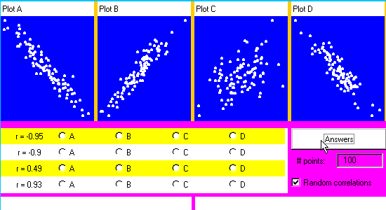
exercise

Slide 24




